Slide 1
ADEMP
Aims
Data
Estimands
Methods
Performance

Slide 2
Simulate | DEFINITELY SIMULATE
Use Formula | Simulate
Violated
Assumptions
Hold
Available
Not Available
Closed-Form Solution

Slide 3
Aims
Methods
Performance
Data
Estimands
Precise question
How data are generated
What we target
What we compare
How we judge

Slide 4




Demonstrate a new method
Explore robustness or bias
Compare competing methods
Inform study design

Slide 5
Bad Aims
Determine the sample size
See how the model behaves
Good Aims
Estimate sample size for 80% power ($α$= 0.05) to detect a risk difference of -0.05 when $p_{0}$= 0.25, allowing for 10% dropout.
Estimate sample size for 80% power (𝛼\ = 0.05) to detect a risk difference of -0.05 when 𝑝_0= 0.25, allowing for 10% dropout.
Assess small-sample bias of a Cox model under 30% censoring.

Slide 6

Mean
DGM Co.
Covariates Estimates
Standard Deviation
Correlation
Continuous Outcomes
Interactions
Binary Outcomes
Missing Data
Sample Size
Survival Times

Slide 7

True
Value
True
Value
True
Value

Slide 8


Slide 9



VS
$$p=0.3$$
$$p=0.45$$

Slide 10



VS
$$p=0.3$$
$$p=0.45$$

Slide 11



VS
$$p=0.3$$
$$p=0.45$$

Slide 12
How to use this PowerPoint template
Please follow the steps in the notes section under the slides carefully.
Delete the slides or placeholders you do not wish to include in your presentation.
More slides can be added from the Insert > New Slide option.

Slide 13


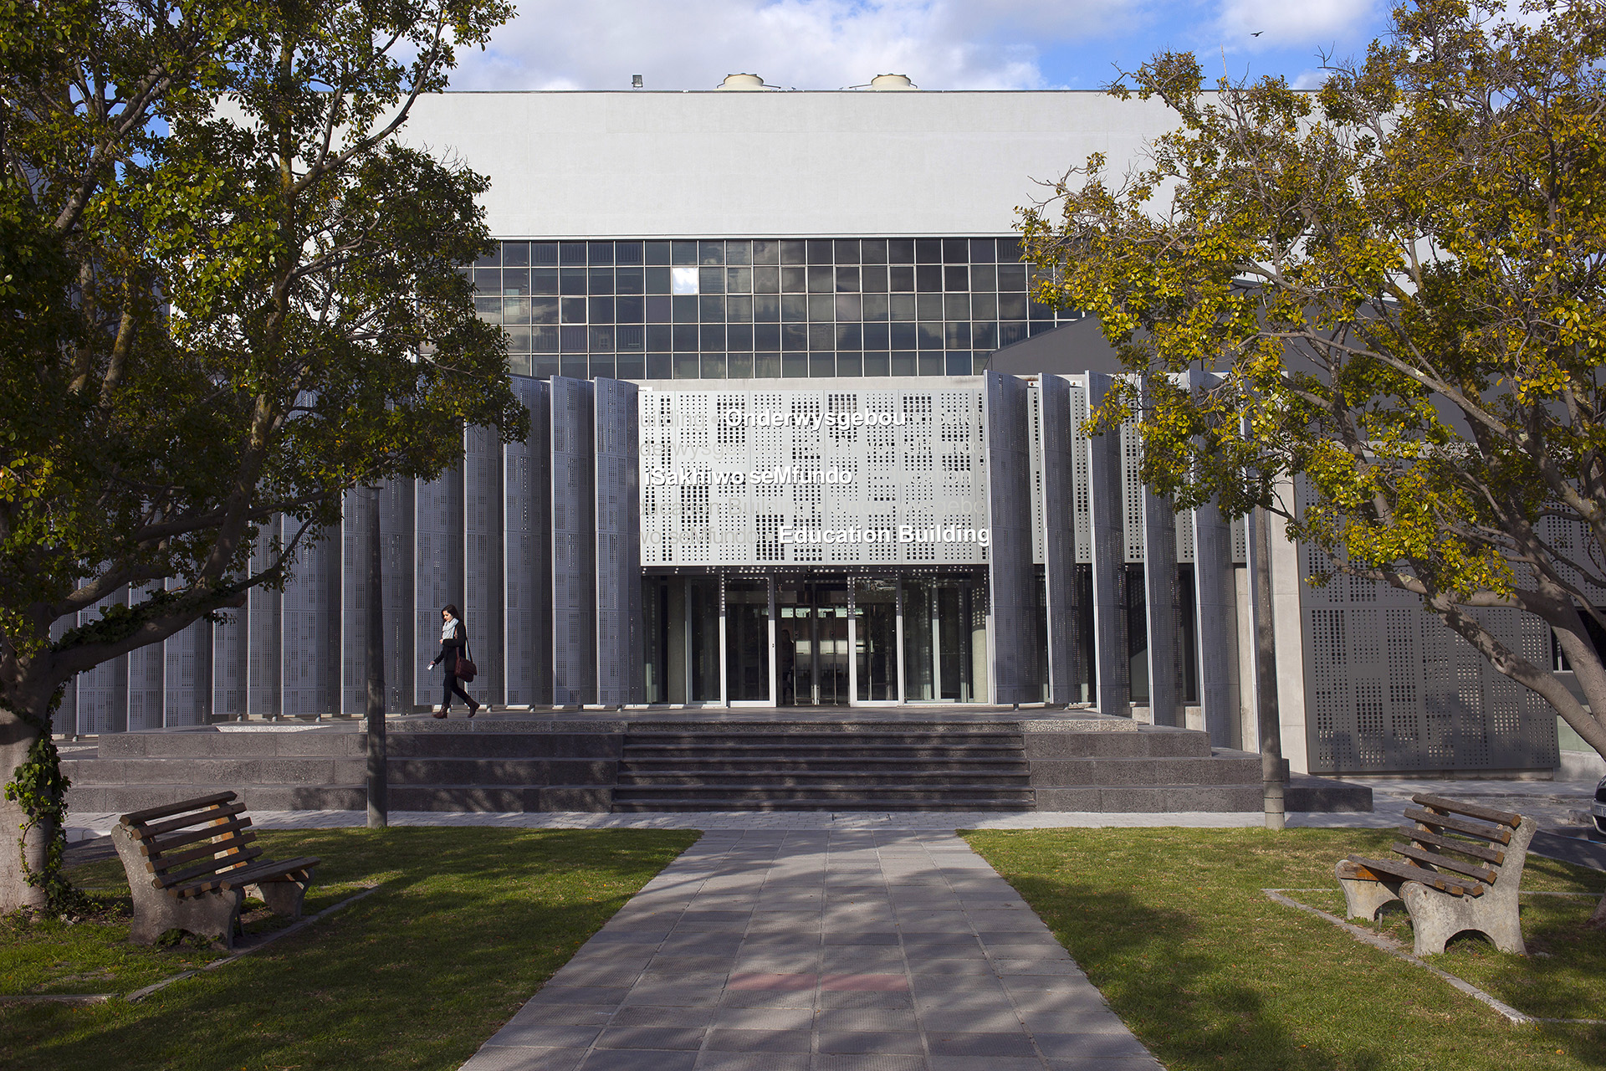
Photo by Stefan Els
Notes:
Picture placeholder slide layout
To change the picture:
Select the picture by clicking on it near the bottom of the slide (under the title placeholder), then click on the Picture Format tab.
Click on the Change Picture icon and choose the From a File/This Device… option.
Browse and select a picture and click on the Insert button.
Use the Crop command to adjust the image.
Click on the Crop command again to apply the changes.
Remember to add image attributions to photographs or artworks.

Slide 14

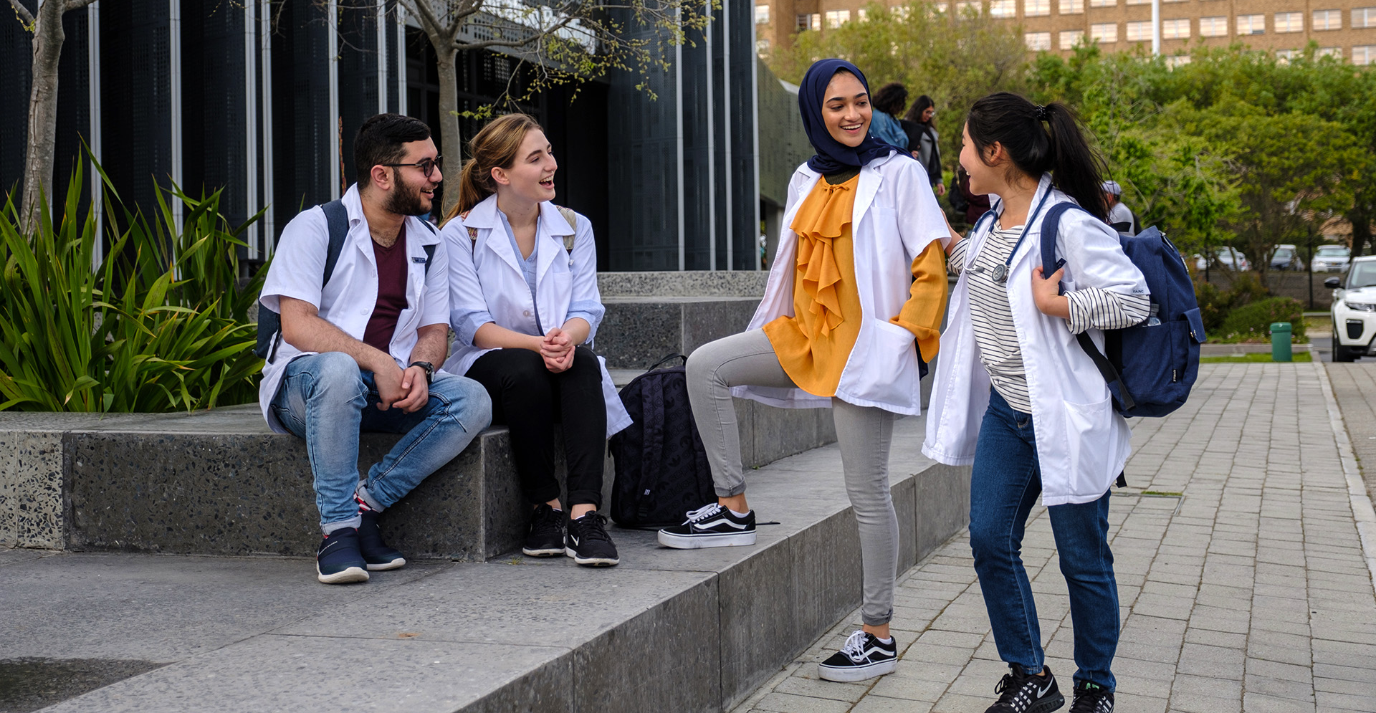
Photo by Stefan Els
Notes:
Picture placeholder slide layout
To change the picture:
Select the picture by clicking on it near the bottom of the slide (under the title placeholder), then click on the Picture Format tab.
Click on the Change Picture icon and choose the From a File/This Device… option.
Browse and select a picture and click on the Insert button.
Use the Crop command to adjust the image.
Click on the Crop command again to apply the changes.
Remember to add image attributions to photographs or artworks.

Slide 15

Photo by Stefan Els
Notes:
Picture placeholder slide layout
To change the picture:
Select the picture by clicking on it near the bottom of the slide (under the title placeholder), then click on the Picture Format tab.
Click on the Change Picture icon and choose the From a File/This Device… option.
Browse and select a picture and click on the Insert button.
Use the Crop command to adjust the image.
Click on the Crop command again to apply the changes.
Remember to add image attributions to photographs or artworks.

Slide 16
Notes:
Solid maroon background slide
The ghost text placeholder is fully scalable and movable.
To add a background image:
Right-click on the slide and choose Format Background …
Click on the Picture or texture fill option and click on the Insert button.
Browse and select a picture and click on the Insert button.
Remember to add image attributions to photographs or artworks.

Slide 17



Photo by Stefan Els
Notes:
Cover/End slide layout
To change the picture:
Select the picture by clicking on it near the bottom of the slide (under the title placeholder), then click on the Picture Format tab.
Click on the Change Picture icon and choose the From a File/This Device… option.
Browse and select a picture and click on the Insert button.
Use the Crop command to adjust the image.
Click on the Crop command again to apply the changes.
Remember to add image attributions to photographs or artworks.

Slide 18
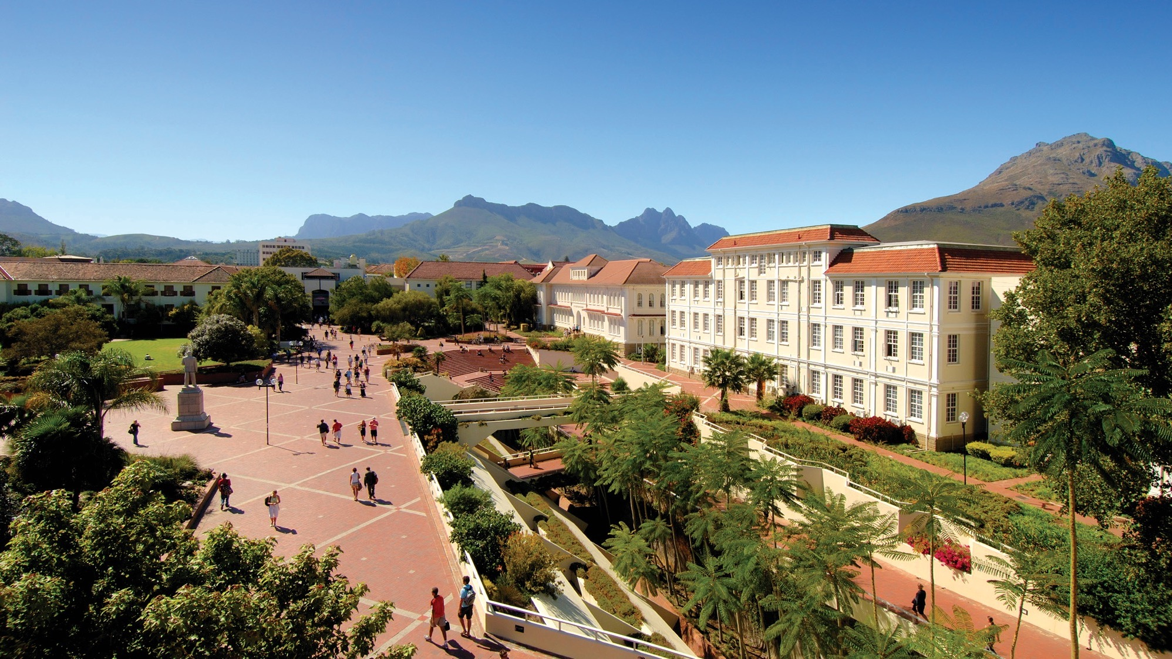
Photo by Stefan Els
Notes:
Cover/End slide layout
To change the picture:
Select the picture by clicking on it near the bottom of the slide (under the title placeholder), then click on the Picture Format tab.
Click on the Change Picture icon and choose the From a File/This Device… option.
Browse and select a picture and click on the Insert button.
Use the Crop command to adjust the image.
Click on the Crop command again to apply the changes.
Remember to add image attributions to photographs or artworks.

Slide 19



Photo by Stefan Els
Notes:
Cover/End slide layout
To change the picture:
Select the picture by clicking on it near the bottom of the slide (under the title placeholder), then click on the Picture Format tab.
Click on the Change Picture icon and choose the From a File/This Device… option.
Browse and select a picture and click on the Insert button.
Use the Crop command to adjust the image.
Click on the Crop command again to apply the changes.
Remember to add image attributions to photographs or artworks.

Slide 35
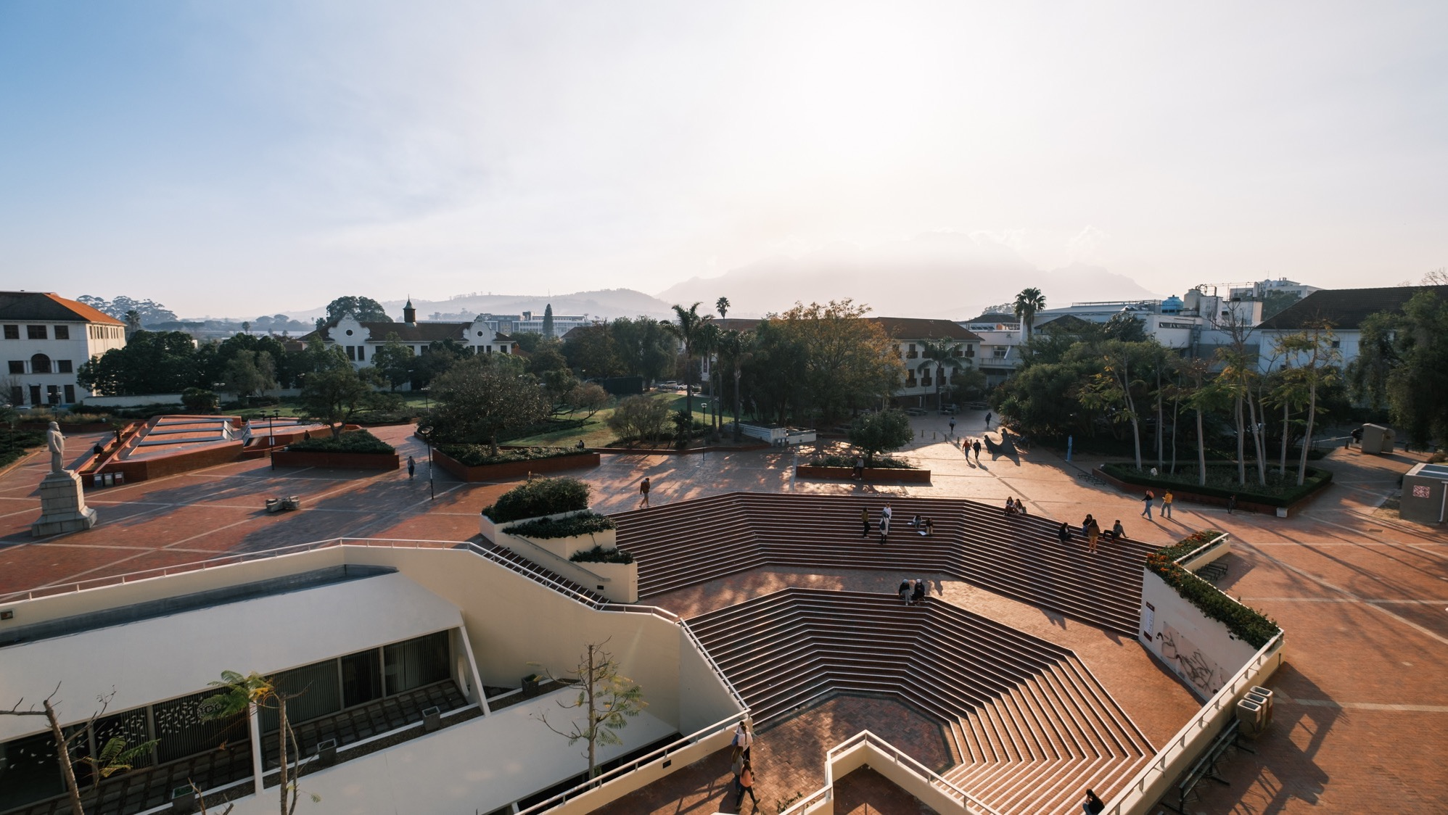
Thank you Enkosi Dankie
Photo by Stefan Els
Notes:
Cover/End slide layout
To change the picture:
Select the picture by clicking on it near the bottom of the slide (under the title placeholder), then click on the Picture Format tab.
Click on the Change Picture icon and choose the From a File/This Device… option.
Browse and select a picture and click on the Insert button.
Use the Crop command to adjust the image.
Click on the Crop command again to apply the changes.
Remember to add image attributions to photographs or artworks.

Slide 36
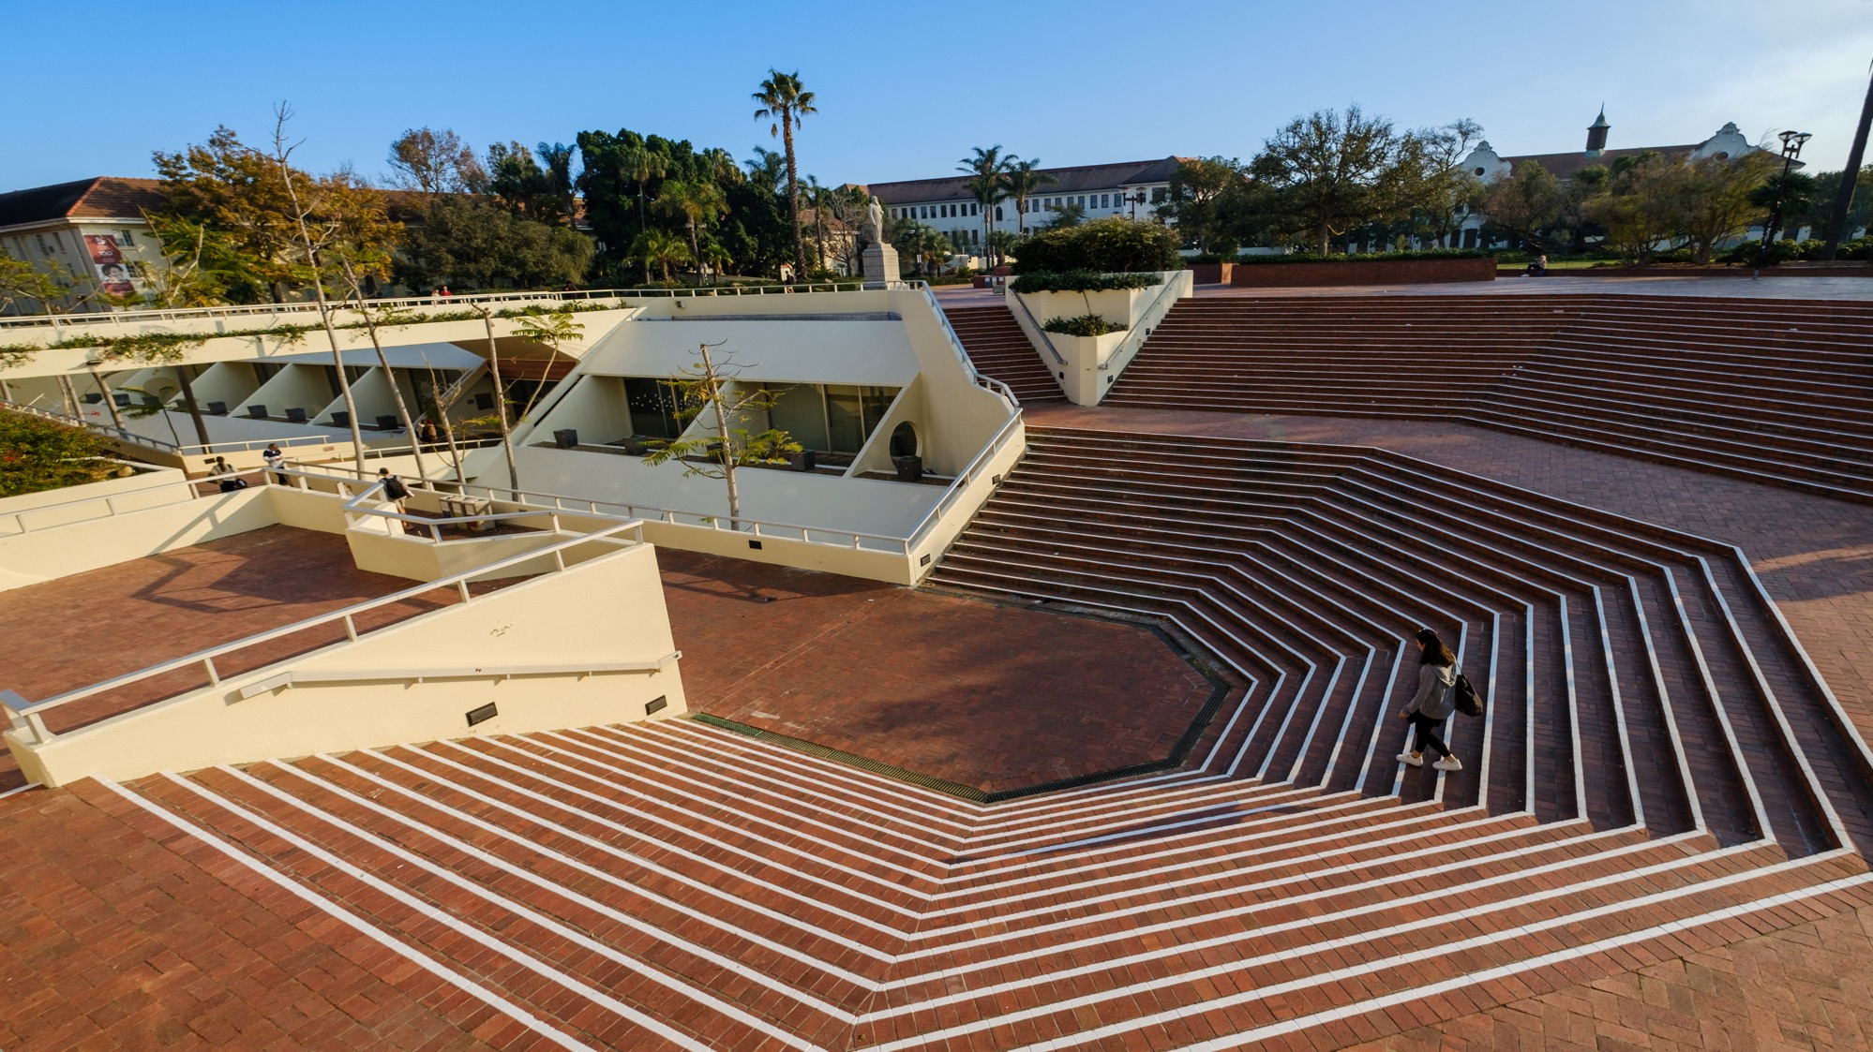

Thank you Enkosi Dankie
Photo by Stefan Els
Notes:
Cover/End slide layout
To change the picture:
Select the picture by clicking on it near the bottom of the slide (under the title placeholder), then click on the Picture Format tab.
Click on the Change Picture icon and choose the From a File/This Device… option.
Browse and select a picture and click on the Insert button.
Use the Crop command to adjust the image.
Click on the Crop command again to apply the changes.
Remember to add image attributions to photographs or artworks.

